Slide 1

Employee Management System
Object Oriented Programming
ICA 3
Group No: 13

Slide 2
Group Members
2020/ICTS/41 : N.A.G.I.N.Abeysinghe
2020/ICTS/43 :K.M.S.R.Samarakoon
2020/ICTS/84 :L.M.S.Perera
2020/ICTS/105 :R.M.S.K.Ranathunga
2020/ICTS/129 :R.A.S.C.Rupasinghe

Slide 3
Content
Introduction
OOP concepts contain
Inheritance
Polymorphism
Abstraction
Encapsulation
Code Discussion

Slide 4

Introduction
Our project is mainly aimed at an Employee Management system by using OOP concepts. It provides you details of an employee. According to the salary of an employee, it will check whether the employee can have a chance to move abroad or not.

Slide 5
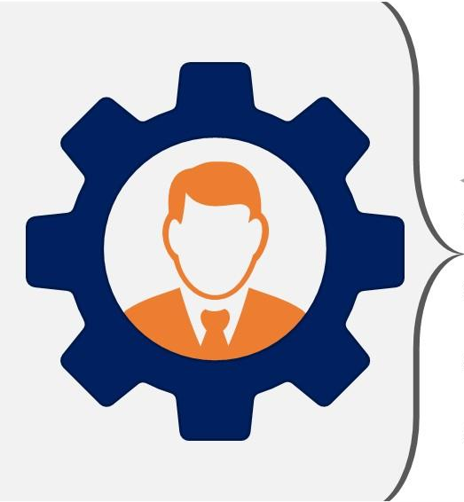
OOP concepts contain
We use basic OOP concepts in our project.
They are,
1. Inheritance
2. Polymorphism
3. Abstraction
4. Encapsulation

Slide 6
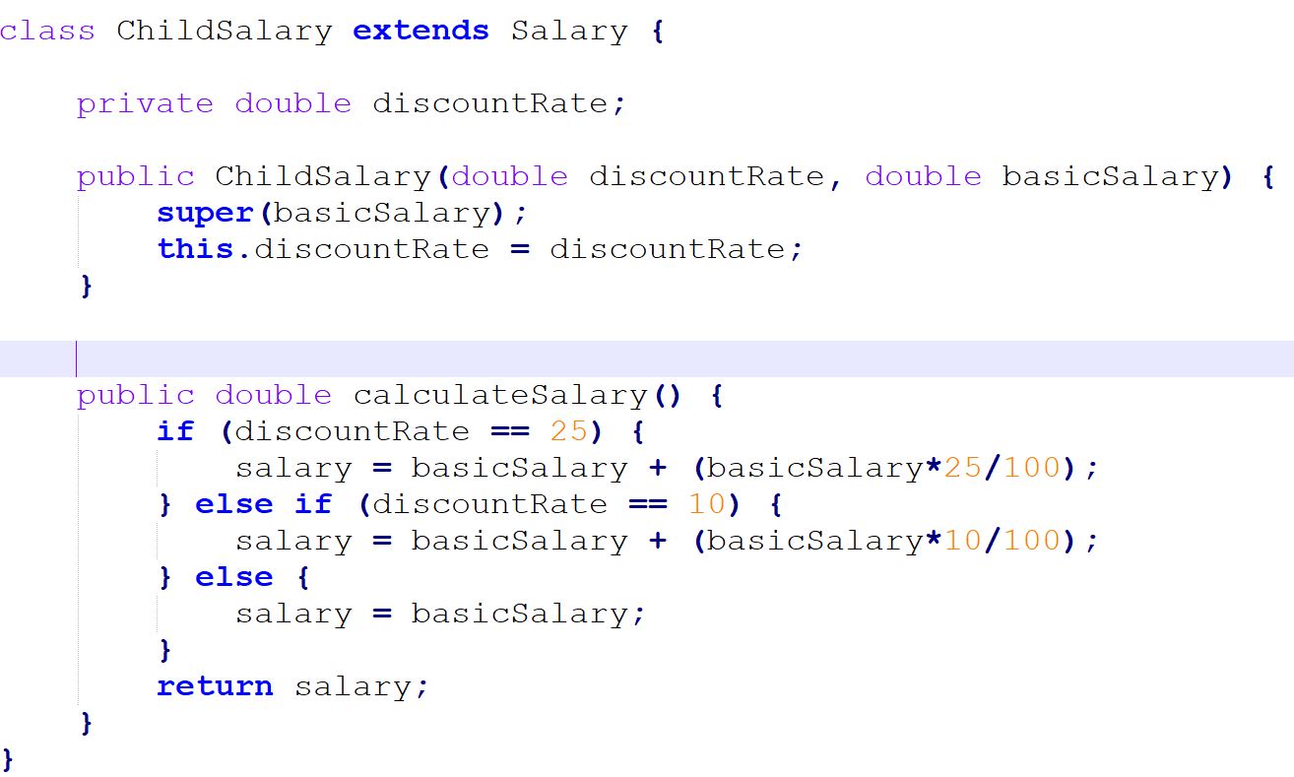
Inheritance
We use inheritance in the following state of our code.

Slide 7
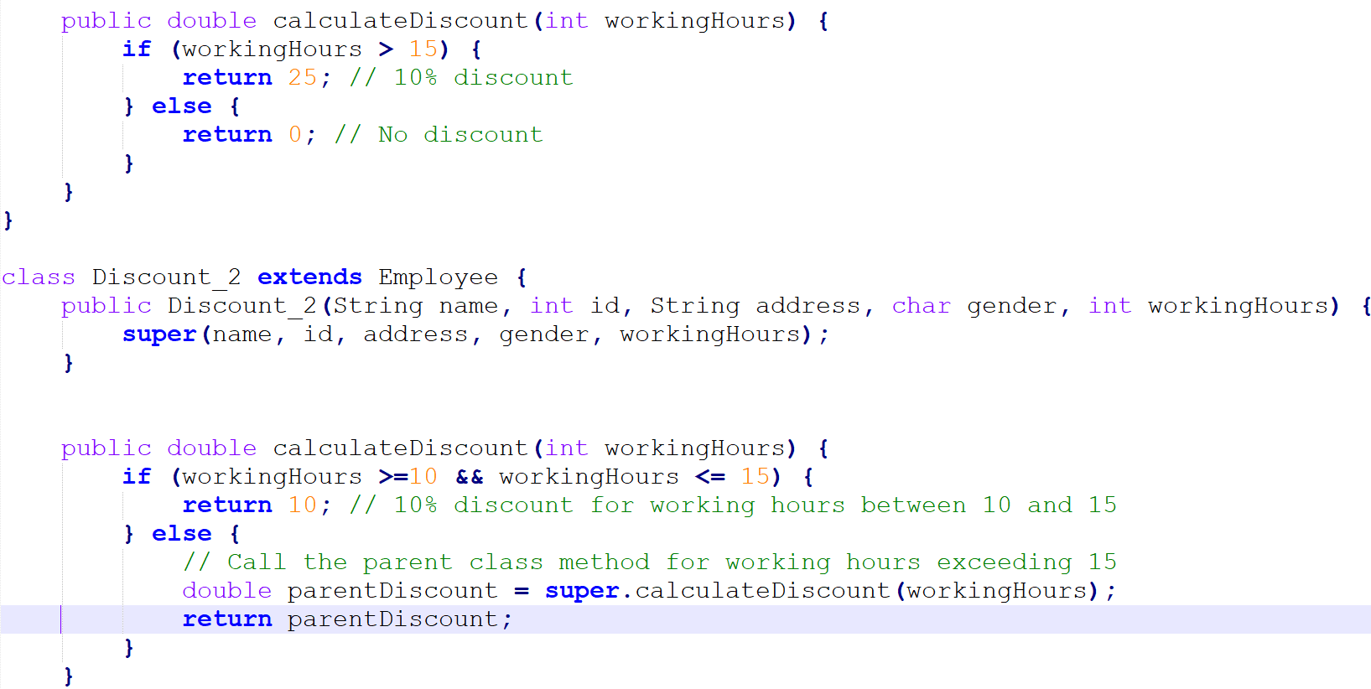
Polymorphism
We use polymorphism in the following state of our code.

Slide 8
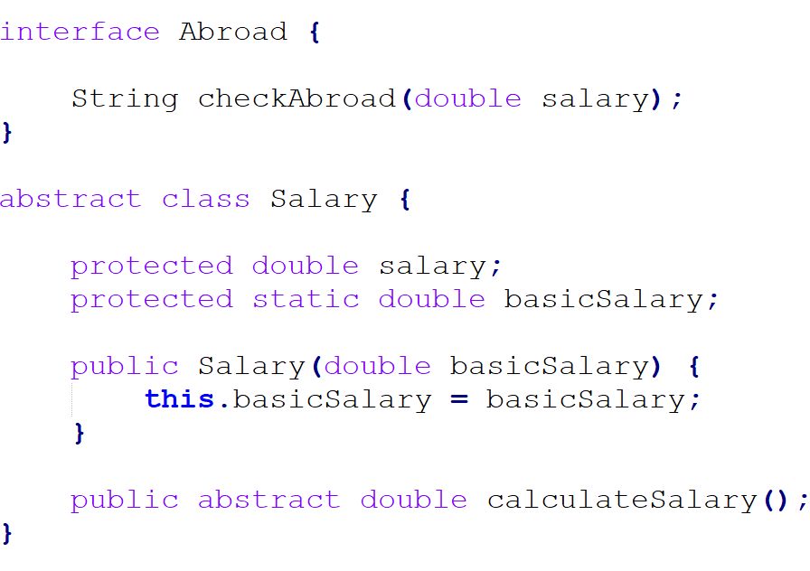
Abstraction
We use abstraction in the following state of our code.

Slide 9
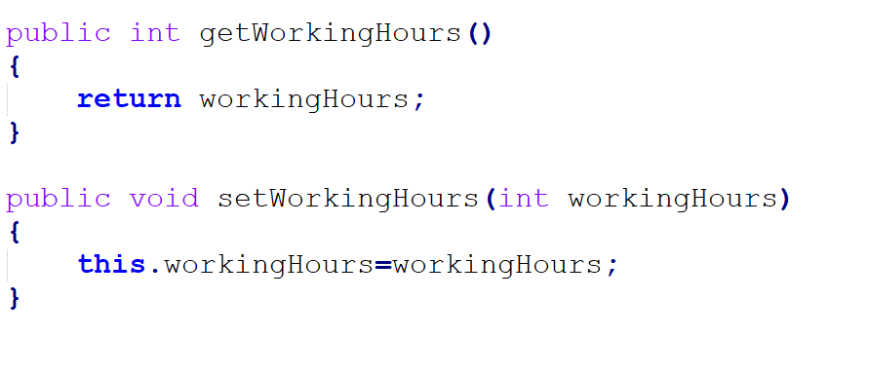
Encapsulation
We use encapsulation in the following state of our code.

Slide 10

Code Discussion
Let’s move to our poject!!
r

